Slide 1
Data Ethics in IoT
Controversies & Recommendations

Slide 2
Data Ethics in IoT
Internet of Things (IoT)
The Network of physical devices from sensors and actuators together with electronics connected over the internet and a background of software and data engineering that allows for exchange and processing of data to come up with solutions and services
IoT in our lives
Smart Phones
Smart Homes
Connected Vehicles

Slide 3
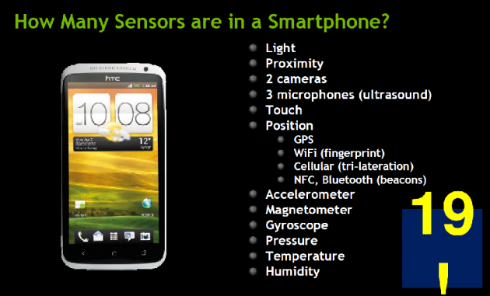
Data Ethics in IoT
Smart Phones
A cell phone may have no less
than 19 sensors, all of which may save
Info to the phone (Face & Fingerprint
Recognition) or to third parties via
Online apps such as Facebook, Twitter
Phone manufacturers (Apple & Siri)

Slide 4
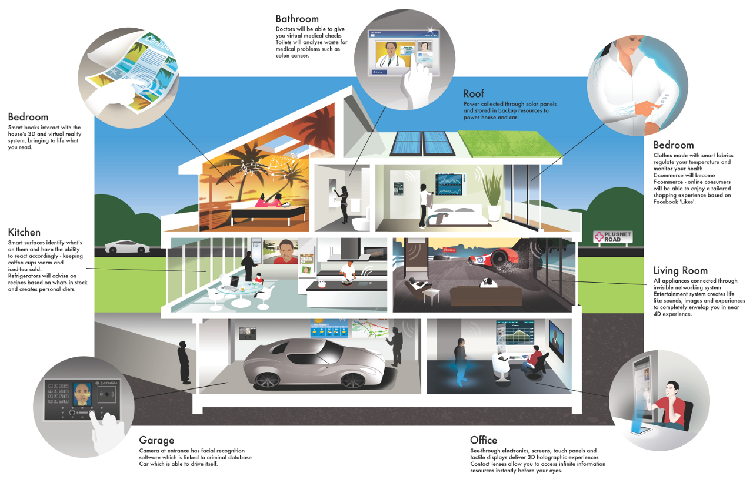
Data Ethics in IoT
Smart Homes
Smart homes with automatic
Lighting and doors opening as well
as personal assistants that control
House appliances by orders given
orally via voice recognition are
Becoming more and more
Common.

Slide 5
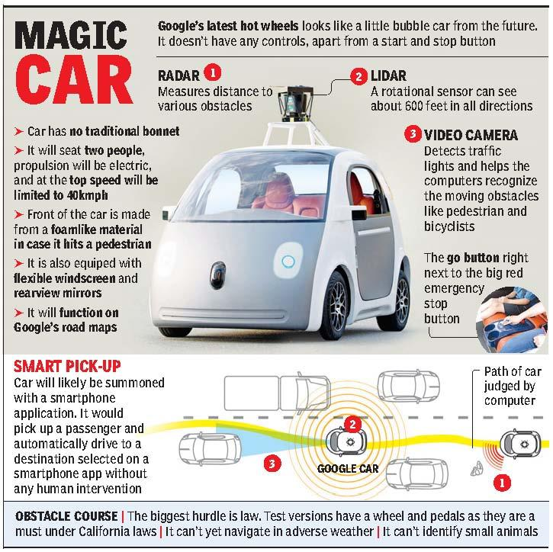
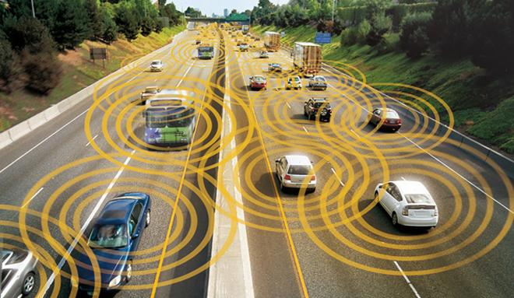
Data Ethics in IoT
Connected Vehicles
Vehicles that record coordinates via GPS as well as Sense
the existence and proximity of nearby cars, an advanced
generation is self-driving cars .

Slide 6
Data Ethics in IoT
Risks of development of IoT
Data Security
Data Privacy & Consent
Exploitation of data owners

Slide 7
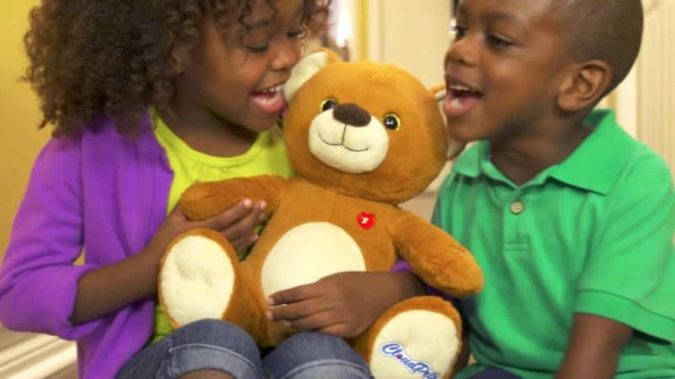
Data Ethics in IoT
Data Security
Data from IoT devices are usually saved
onto cloud servers which leaves such
data vulnerable to hackers if no enough
procedures are done to ensure its safety.
An incident when data security was
compromised was when IoT Teddy Bear
Christmas gift leaked info of 2+ million families
Including passwords and voice messages.

Slide 8
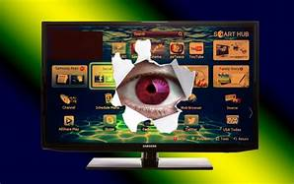
Data Ethics in IoT
Data Privacy and Consent
Before collecting data it’s important to ensure
* Clients awareness of & agreement to data obtained
as well as who has access to it.
* Data is transferred in a discreet, safe form.
One of the issues that surfaced that kind of case
Was news of Samsung smart TVs sending unencrypted
voice recognition data across internet from involuntary
Viewers of their smart TVs

Slide 9

Data Ethics in IoT
Data Exploitation
Data collected by free websites are not only
Used for recommendation systems, but also
Frequently deployed for ad generation, such
Exploitation of users is the subject of controversy
In the new millennia.

Slide 10
Data Ethics in IoT
IoT “Bill of Rights”
People own the data they (or their “things”) create.
People own the data someone else creates about them.
People have the right to access data gathered from public space.
People have the right to access their data in full resolution in real-time.
People have the right to access their data in a standard format.
People have the right to delete or backup their data.
People have the right to use and share their data however they want.
People have the right to keep their data private.

Slide 11
Data Ethics in IoT
Our Recommendations
Develop IoT Standards
Simplified Terms of Use and opt-out Options
De-Identification is Not Enough
Complete Transparency even after consent
Establish laws to limit nonconsensual use of IoT data

Slide 12
Data Ethics in IoT
Develop IoT Standards
Having a universal standard for IoT designers allow designers and developers,
whether in entities or individuals to employ user-friendly and secure products,
it would allow marketers to focus on user experience and be able to fulfill
potential for innovation and efficiency. These standards must cover
everything from technical to legal and ethical issues of IoT.

Slide 13
Data Ethics in IoT
Simplified Terms of Use and opt-out Options
It seems that “Notices and Guidelines” of possible breaches of privacy in
current “Terms of Use” are rather lengthy fingerprints to force readers to
accept them without having much of a say. Due to sensitivity and richness of
IoT datasets, such practices cannot continue. Terms of Use of IoT devices must
clarify any collection, usage or sharing of data unrelated to the expected
function of the device itself. It must also provide an opt-out option.

Slide 14
Data Ethics in IoT
De-Identification is Not Enough
A critical Issue is that companies are allowed to gather involuntary data
without consent as long as such data is de-identified. However, since
technologies exist that identify individuals from unidentified and unassociated
datasets, it is required to establish laws such that risk of identification is spelled
out

Slide 15
Data Ethics in IoT
Complete Transparency even after consent
Even after users agree to Terms of Use, companies must be fully transparent
on what data they collect, who gets access to it, what purposes it deploys
them to and most importantly how they keep data secure, an option to
revoke consent later with knowledge of previously acquired datasets is also
important.

Slide 16
Data Ethics in IoT
Establish laws to limit nonconsensual use of IoT data
Industries such as insurance are eager to use IoT. Insurance is as important as
credit, employment and housing, usage of IoT for insurance decisions must be
regulated and also require explicit “Notice and Choice”

Slide 17
Questions..
Data Ethics in iot

